Slide 1
CA Scheduler 7

Slide 2
Topics Discussed
Introduction
Database
CA-7 Screen Structure
Job Scheduling Basics
Schedules/Calendar/Jobs
Job Queues and Job Cycle
Commands
Tips
Interfaces

Slide 3
What is CA Scheduler?
CA7 is the workload Job scheduler. CA Scheduler automates workload scheduling and management. The production workload can be fully automated based on multiple criteria, including job dependencies, resource availability and time.

Slide 4
Maintaining Database

Slide 5
Database
The CA7 Database is Comprised of
Schedules
Jobs
Calendars
Date tables

Slide 6
Database Contd…
Schedule is a group of logically related jobs.
Job is a CA-Scheduler object which can execute a JCL. Any number of Jobs can execute the same JCL.
Calendars and Date tables are customized calendars for a specific year that can be defined by the user/programmer.

Slide 7
Database Contd…
The CA7 Database is using series of Formatted Screens .The Screens are organized based on their Functions
The Data Base has the information about
  Jobs
  Triggers
  Job Schedule
  Job Requirements
  Job Dependency
  Job statistics
  JCL
  Work Load Balancing Information and More…..

Slide 8

Job Submission
Manual Job Submission
JCL
JES
Database
JCL
CA7
Automatic Job Submission
JES

Slide 9
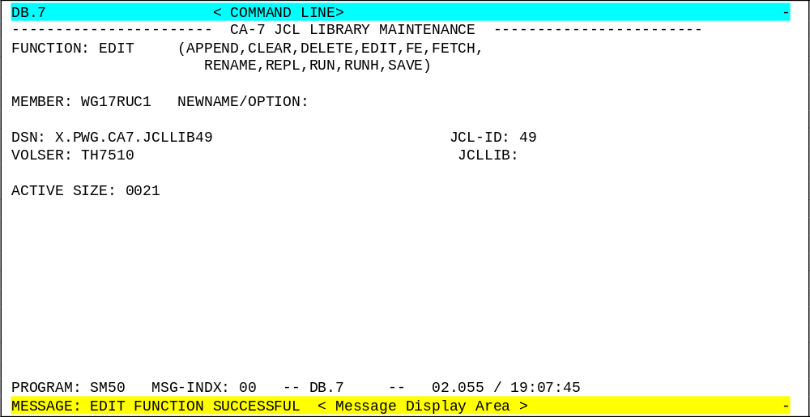
CA7 Screen
Any CA7 Screen could be distinctly identified into Command Line, Message Display Line and Formatted Display Area

Slide 10
CA7 SCREENS
A CA7 Screen can be broadly divided in to Two areas
1. COMMAND LINE
The top most line of the screen is the Command line.The Command Prompt won’t be explicit.
Commands should be typed from top left
2. FORMATTED DISPLAY AREA
This is the remaining area of the screen other than the Command Line. The contents of the Screen vary according to the screen we use.
The Last Line in the Formatted Screen will be the Message Display Area (The response area)
ACCESSING A CA7 SCREEN:
A required screen can be reached either by menu selection Option or or by Jump directly through Screen id
E.g. :
JOB have Screen ID as DB.1
JCL have Screen ID as DB.7

Slide 11
CA7 Screens Structure
Main menu
DB
Job
DB . 1
SCHID MENU
DB . 2
JobSchd
DB.2.1
In/OutNet Schd
DB.2.2
DB.2.3
JobTrig
DB.2.4
InNet
Trig
DB.2.5
JobSchd
DB.2.6
JobSchd
DB.2.7
DEP MENU
DB . 3
DSN DEPs
DB. 3.1
JOB DEPs
DB.3.2
In / Out DEPsTrig
DB. 3.4
User DEPs
DB. 3 . 6
RPT
DB. 3 7
Doc MENU
DB . 4
Network MENU
DB . 5
DSN MENU
DB . 6
JCL
DB . 7
JCL Override Lib 254

Slide 12
DB.1 Screen
used to maintain a job in the scheduler.
------------------------- CA-7 CPU JOB DEFINITION --------------------------
FUNCTION: (ADD,DELETE,DD,PURGE,DELPRRN,FORMAT,LIST,UPD)
JOB:
GENERAL: SYSTEM: JOBNET: OWNER: UID:
JCL: ID: MEMBER: RELOAD: EXEC: RETAIN-JCL:
LIB:
REQUIREMENTS: HOLD: JCL-OVRD: USE-OVRD-LIB: VERIFY: MAINT:
SATISFACTION LEAD-TIME: JOB: DSN: ARFSET:
EXECUTION: MAINID: INSERT-RMS: COND-CODE: RO:
DONT SCHEDULE -- BEFORE: AFTER:
MESSAGES: LTERM: REQUIREMENT-LIST: PROMPTS:
ERROR MSGS -- RQMTS NOT USED: DSN NOT FOUND:
RESOURCES: REGION: CLOCK-TIME: CPU-TIME:
CLASS: PRTY: MSGCLASS:
TAPE DRIVES...TYPE1: M C TYPE2: M C
PROGRAM: SM20 MSG-INDX: 00 -- DB.1 -- 02.106 / 10:28:56
MESSAGE: ENTER FUNCTION, TRANSFER OR ENTER A COMMAND ON THE TOP LINE

Slide 13
DB.2.4 Screen
used to List, Delete and Add a successor job
--------------------------- CA-7 JOB TRIGGERING ----------------------------
FUNCTION: LIST (FORMAT,LIST,UPD) PAGE 0001
JOB: WF17RRC1
OPT SCHID TRGD-JOB TRGID DOTM QTM LDTM SBTM *---- EXCEPTIONS ----*
002 WFP0RRD1 0010
002 WF1ERRC1 0010
002 WF6ARRC1 0010
OPTIONS: A=ADD,D=DELETE,U=UPDATE,*=PROCESSED,?=ERROR
PROGRAM: SM75 MSG-INDX: 00 -- DB.2.4 -- 02.106 / 10:34:26
MESSAGE: LIST FUNCTION SUCCESSFUL
END OF DATA REACHED

Slide 14
DB.3.2 menu
used to Add, Delete and List Predecessors for a job.
------------------------ CA-7 CPU JOB PREDECESSORS -------------------------
FUNCTION: LIST (FORMAT,LIST,UPD) PAGE 0001
PRED FOR JOB: WFS0RRCD LIST-SCHID:
OPT SCHID LEADTM PRED-JOB NEXT-RUN
2 0005 WF00RRAC YES
OPTIONS: A=ADD,D=DELETE,U=UPDATE,*=PROCESSED,?=ERROR
PROGRAM: SM61 MSG-INDX: 00 -- DB.3.2 -- 02.106 / 10:59:17
MESSAGE: LIST FUNCTION SUCCESSFUL
END OF DATA REACHED

Slide 15
DB.3.6 Screen
To Add Delete and List the reasons for a job
to be held in Request queue.
--------------------- CA-7 USER MEMO-FORM PREDECESSORS ---------------------
FUNCTION: LIST (FORMAT,LIST,UPD) PAGE 0001
PRED FOR JOB: WFSTRRT LIST-SCHID:
OPT SCHID *--- MEMO-FORM USER PREDECESSOR ---* NEXT-RUN
0 WAIT FOR START TIME YES
OPTIONS: A=ADD,D=DELETE,U=UPDATE,*=PROCESSED,?=ERROR
PROGRAM: SM61 MSG-INDX: 00 -- DB.3.6 -- 02.106 / 11:09:47
MESSAGE: LIST FUNCTION SUCCESSFUL
END OF DATA REACHED

Slide 16
Job Scheduling Architecture
A Schedule can be of various Process Architectures
The Process architecture could be broadly classified as four different types
  Simple Architecture
  Single Path - Multi Job Architecture
  Multi Path - Multi Job Architecture
  Parallel Processing Architecture
Based on the requirement of the system a suitable combination of the process type is assigned to the Schedule.

Slide 17
Architecture Types
Simple (Single Job) Architecture
Single Path - Multi Job Architecture
Start
Start
JOB1
Job
JOB2
End
End
Each of the Job in the Flow waits
till its predecessor finishes.
It is the most common type
Eg: Pre/ Post Batch backups
IDCAMS copy of VSAM/Flat files

Slide 18
Architecture Types Contd…
Multi Path - Multi Job Architecture
Parallel Processing Architecture
Start
Decision to Execute
Any Path
Start
JOB A
JOB1
JOB X
JOB A
JOB1
JOBX
JOB2
JOB Y
JOB2
JOB Y
JOB Z
JOB Z
JOB N
End
End
Process can take any of the process flow based on Schedule Id criteria
E.g.:
Start-->Job1--> End ( Daily)
Start-->Job A--Job B. --> End ( Weekly)
Start-->Job X--Job Y--Job Z. --> End ( Monthly)
Multiple jobs are processed Simultaneously
Often the common points have Dummy Job (Job N) at the start and end of Parallel Paths.
This requires all paths finish executing before common Path starts
Segmented Jobs executing in Parallel are best Example for this

Slide 19
Jobs/Schedules/Calendars
      Define
      Alter
      Delete

Slide 20
DEFINING JOBS
Job Definition is the Process of Introducing a Job to the Scheduler.
This can be done in two ways
  Screens
  Submitting Batch Jobs

Slide 21
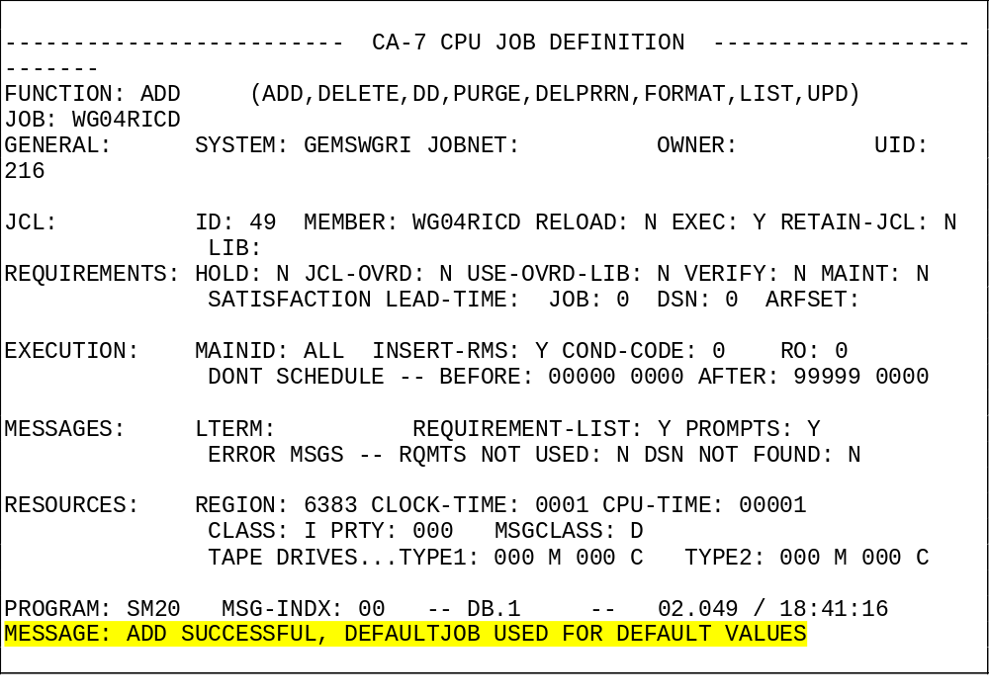
Job Addition -SCREEN
This is done by DB.1 Screen

Slide 22
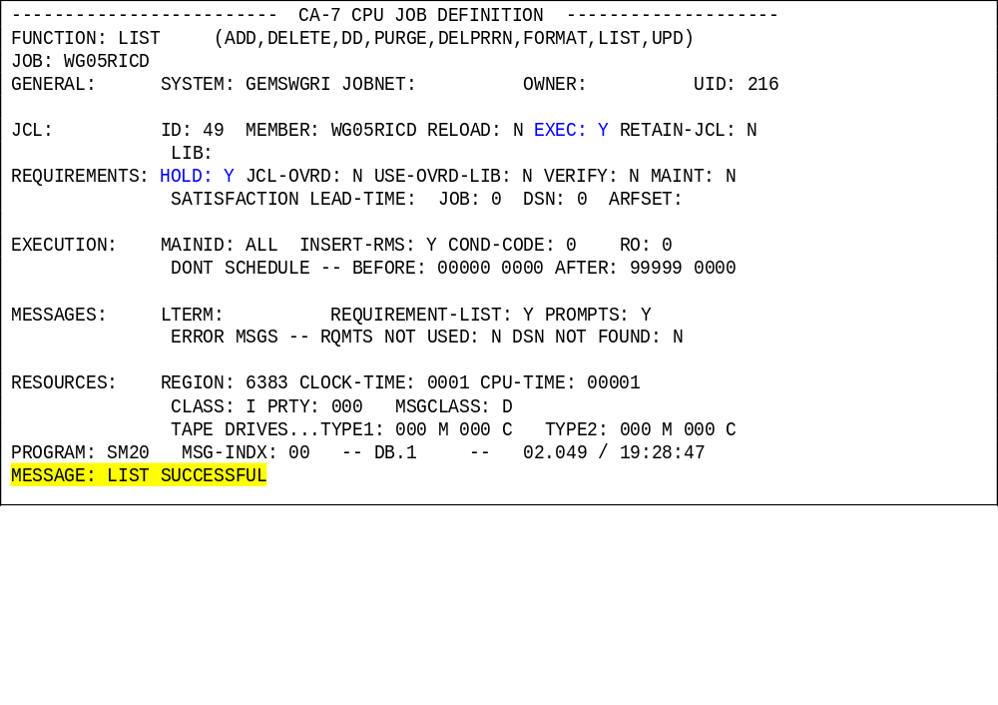
The Screen Lists the Added Job. The Job Attributes are Grouped under six Categories 1. General 2.JCL 3.Rqmt 4.Execution 5. Msg
6. Resources. The significant fields are EXEC, HOLD, UID
Job Addition

Slide 23
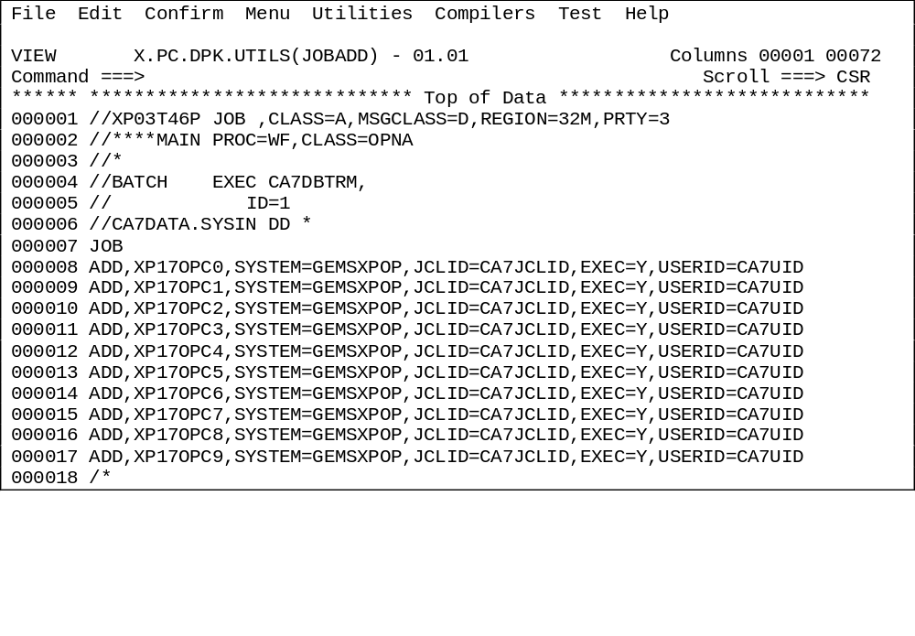
Adding job in CA scheduler through JCL Submission :
The method is preferred to add a large number of Jobs at one shot into the system. The below JCL is an Example
Job Addition

Slide 24
Alter Job
Similar to Job Definition , Job Parameter Alteration could also be done in two ways
Before executing the Batch, the Job attributes can be Altered
  Holding the Jobs after Date roll, Posting,etc., So that some required verifications / Corrections can be done and then the batch can be carried forward.
  Making the Job Non-Exec (When a Job is made Non-exec it actually does not run but satisfies all the dependencies & trigger requirements in the Batch)

Slide 25
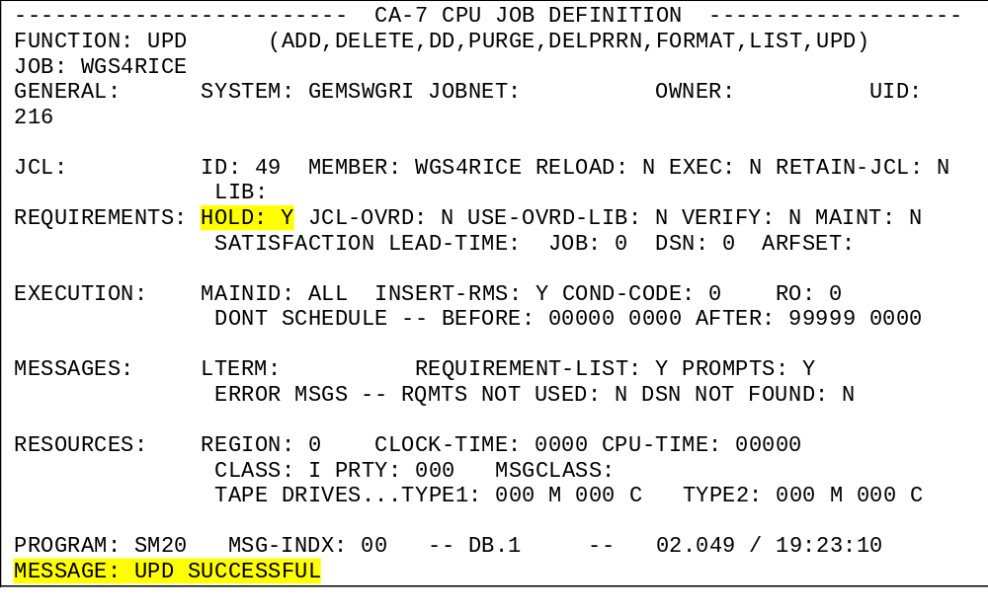
Job Attribute Alteration through SCREENS
The Job after Posting is set HOLD=Y
Alter Job

Slide 26
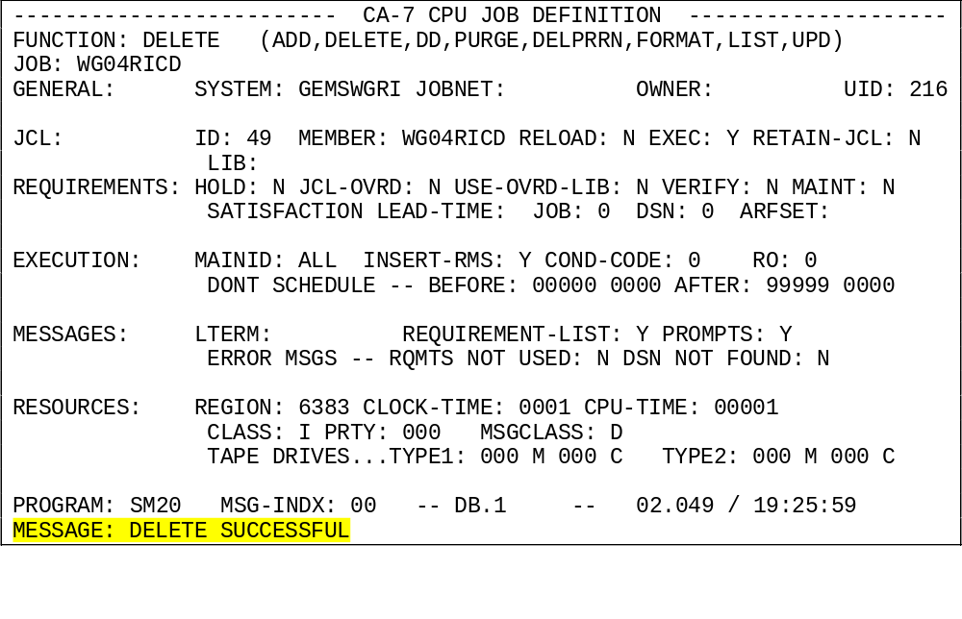
Delete Job
Deleting is the process of Removing the Job from the CA7 Database

Slide 27
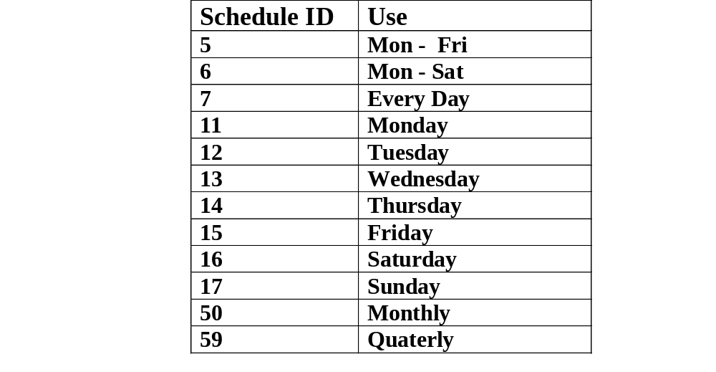
Schedules
A Schedule is nothing but a group of logically related Jobs.
Similar to a Adding/Altering/ Deleting Jobs the entire Schedule could be handled.
The Schedule Maintenance are vitally used in Live Regions and bit complicated in the Test and Development regions.
Each Schedule is assigned and are identified by their Schids.

Slide 28
CALENDERS

Slide 29
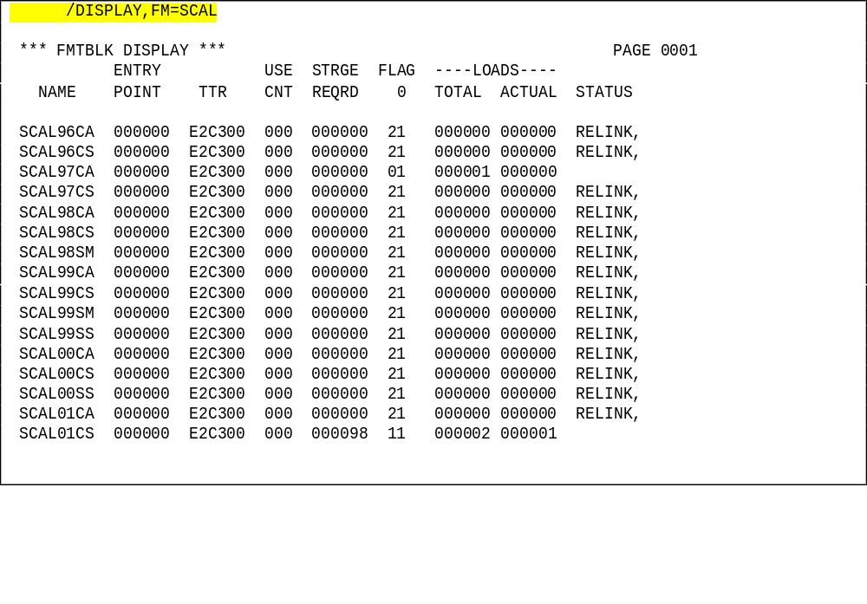
Calendars are used in CA7 to define non-working days and Holidays. Calendars are predominantly used in Live Schedulers and usually ignored in the test / development CA-7 Schedulers. The command to display all calendars defined in Scheduler is
/DISPLAY,FM=SCAL
Calendars

Slide 30
Calendar Naming Convention normally varies between installations
Calendars Contd…
Any how the Calendar name consists of three parts
SCAL<yy>CS
Identify the Function of the Calendar
CA - 7 days per Week
CS - 6 Days per week Excluding Sunday
CM- 6 Days per Week Excluding Monday
WD - week Day Only Calendar
E.g.: SCAL99CA
Two Digit Year
Default Literal

Slide 31
Calendars Contd…
Periods of the CA7 calendar can be setup which does not correspond to Normal Calendar . This feature enables more formatted Month end and Year end processing. Further ensures the smooth Transition of the Year end Processing .
For Instance … 1. The CA7 Calendar could be offset as below
APRIL 1 - (Financial) New Year Starts
MAR 31 - (Financial) New Year Ends.
The year end Jobs can be suitably scheduled to ensure trouble-free year end Processing
2. We can Define
No of Days in a Month = 28 / 35 Days
This ensures the Monthly Jobs to Run in the 4 /5 Week cycle and fall in the desired Weekend day instead a Mid week-day

Slide 32
Calendars Contd…
Example for three different types of Calendars.
1. 7 Days per Week (SCALyyCA)
2. 6 Days per Week excluding Sunday (SCALyyCS)
3. 6 Days per Week excluding Monday (SCALyyCM)
It is Possible to define Bank Holiday and the non-Schedule days in CA7. Individual Job Schedules can be changed if a particular Job is not required to be run on a Bank Holiday

Slide 33
Selection of Schedules and jobs
The reserved words that cause schedules and jobs to be selected on a given day are as follows:
DAILY, WEEK-DAY, WEEK-END, SUN, MON, JAN, DEC, 1ST, 31ST.

Slide 34
Processing Periods
Day of Week
Day of Month
Workday
Relative Day
Holiday

Slide 35
Predecessor Condition
A schedule or job can be used to determine selection. When it is used, it automatically becomes a predecessor as well

Slide 36
The Absolute Gregorian Calendar
defines specific keywords that have absolute dates associated with them. For example, the DAILY keyword causes a job to be selected every day including weekends and holidays; WEEK-DAY causes selection on Monday through Friday including holidays; and so on. This mechanism is determined by the system and you do not have to define anything just use the keywords.

Slide 37
Date Tables
define workdays, holidays, accounting days, and accounting periods. This is the most flexible calendar mechanism and is the one recommended. It also provides the easiest transition at year end. Each schedule defines which date table to use for evaluating when to select that schedule and its associated jobs.

Slide 38
JCL FACILITIES
Declared Libraries
Job Screen Facilities
JCL Commands
JCL Overrides

Slide 39
DECLARED LIBRARIES
The JCL for the Jobs using CA7 facilities will reside on a Library which is declared to CA7. Each Library is assigned with an unique JCLID ( 0 - 255) For e.g., Override Library - JCLID 254
Library for help Information - JCLID 255
The Command for listing the Libraries assigned to scheduler is
/DISPLAY,ST=JCL

Slide 40
DECLARED LIBRARIES contd…
/DISPLAY,ST=JCL
*** JCL DISPLAY *** PAGE 0003
DATASET NAME INDEX ALT DSORG VOLSER LTERM
X.PWE.CA7.JCLLIB47 047 N/A PDS TH7510 MASTER
X.PWF.CA7.JCLLIB48 048 N/A PDS TH7510 MASTER
X.PWG.CA7.JCLLIB49 049 N/A PDS TH7510 MASTER
X.PXJ.CA7.JCLLIB50 050 N/A PDS TH6847 MASTER
Y2KV.NT.CA7.JCLLIB51 051 N/A PDS TH3090 MASTER
ZS.ZD.CA7.JCLLIB53 053 N/A PDS MIGRAT MASTER
O.CA7.JCLLIB4 054 N/A PDS THS570 MASTER
X.PXP.CA7.JCLLIB55 055 N/A PDS TH3866 MASTER
X.PXX.CA7.JCLLIB56 056 N/A PDS TH6901 MASTER
X.PXY.CA7.JCLLIB57 057 N/A PDS TH3865 MASTER
X.PXZ.CA7.JCLLIB58 058 N/A PDS TH6776 MASTER
X.PWA.CA7.JCLLIB59 059 N/A PDS TH3867 MASTER
PT.ACG.JCLLIB 060 N/A PDS TH8961 MASTER
UKMI.CA7.JCLLIB61 061 N/A PDS TH6220 MASTER
O.CA7D.PRODCTRL.JCLLIB62 062 N/A PDS THS570 MASTER
O.CA7D.JCLOVER 254 N/A PDS THS109 MASTER
P.CA7D.HELP 255 N/A PDS PPT105 MASTER

Slide 41
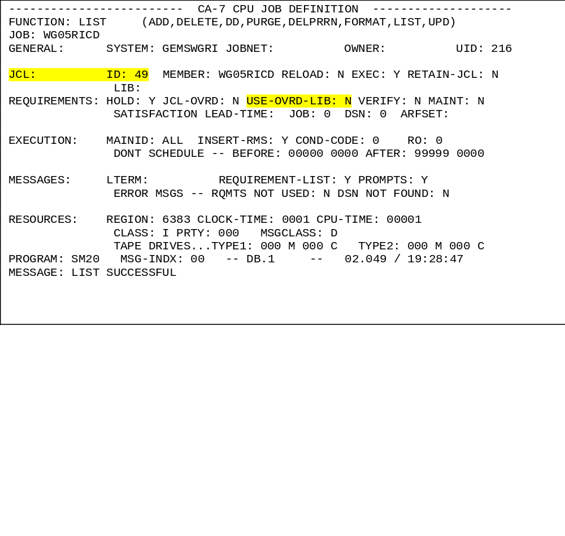
JOB SCREEN FACILITIES
Several Fields in DB.1 Screen are connected to CA7 JCL Facility
USE-OVRD-LIB:
Assigns whether JCL Overrides to be used or not
JCLID:
Each Jcl library is assigned with an Id in Scheduler. In this case it is 49. It means the JCL for the Job resides in the Jcl library 49

Slide 42
JCL Commands & Overrides

Slide 43
DB.7 or JCL
To pull a JCL from any JCL library, in this example from JCL library 49
----------------------- CA-7 JCL LIBRARY MAINTENANCE ---------------
FUNCTION: FE (APPEND,CLEAR,DELETE,EDIT,FE,FETCH,
RENAME,REPL,RUN,RUNH,SAVE)
MEMBER: WE97RFSB NEWNAME/OPTION:
DSN: JCL-ID:
VOLSER: JCLLIB: 49
ACTIVE SIZE: 0000
PROGRAM: SM50 MSG-INDX: 00 -- DB.7 -- 02.105 / 19:20:28
MESSAGE: ENTER FUNCTION, TRANSFER OR ENTER A COMMAND ON THE TOP LINE

Slide 44
DB.7 or JCL Contd…
This screen shows the pulled JCL, and SR is for Save and Replace the existing member of the JCLLIB
----+----10---+----20---+----30---+----40---+----50---+----60---+----70*
SAVE UPPER NOFILL XSEQ (NONUM) I(010)
00010 //WF97RRSB JOB ,TIME=10,CLASS=A,MSGCLASS=D,REGION=0M,PRTY=8
00020 //****MAIN PROC=WF,CLASS=OPNA
00030 //*
00040 //EMSJCL JCLLIB ORDER=X.PWF.RTS.PROCLIB
00050 //*
00060 //*
00070 //** OVERRIDE REQUESTED BY ??????
00080 //*
00090 //JOBLIB DD DSN=EXP.CHMPRD.ZDF6.STG.#000003.BAT,DISP=SHR
00100 // DD DSN=EXP.CHMPRD.XP53.STG.#000018.BL4,DISP=SHR
00110 // DD DSN=EXP.CHMPRD.XP53.STG.#000016.BL4,DISP=SHR
00120 // DD DSN=EXP.CHMPRD.XP53.SYS.BL4,DISP=SHR
00130 // DD DSN=EXP.CHMPRD.XP53.UAT.BL4,DISP=SHR
00140 // DD DSN=X.P.R8002V1.EXECLIB,DISP=SHR
00150 //*
00160 //WF97 EXEC WF97OPSB,RUNXXX='RUN002',RELXXX='JRB1604'
00170 //*
----+----10---+----20---+----30---+----40---+----50---+----60---+----70*

Slide 45
DB.7 or JCL Contd…
After editing the JCL we can replace the existing member in the same JCL library or we can save it to the override library. In this example we are saving the edited member in override library 254.
----------------------- CA-7 JCL LIBRARY MAINTENANCE ------------------------
FUNCTION: SAVE (APPEND,CLEAR,DELETE,EDIT,FE,FETCH,
RENAME,REPL,RUN,RUNH,SAVE)
MEMBER: WF97RRSB NEWNAME/OPTION:
DSN: JCL-ID: 254
VOLSER: JCLLIB:
ACTIVE SIZE: 0017
PROGRAM: SM50 MSG-INDX: 00 -- DB.7 -- 02.106 / 09:46:01
MESSAGE: EDIT FUNCTION SUCCESSFUL

Slide 46
JOB QUEUE
REQUST QUEUE
READY QUEUE
ACTIVE QUEUE

Slide 47
Types of Job Queues
REQUEST QUEUE:
A triggered Job waits in the request Queue until its predecessor Job runs successfully. When a Job is triggered, it first gets into the REQUEST Queue.
The Command to view the Jobs in the Request Queue is
XQJ.
XQM is also a request queue command to see the job’s requirements also.
The command is defaulted in the PF01 Key. Hence we can retrieve the Jobs in
REQUEST QUEUE by hitting PF01.
Maintenance can be performed against any or all of the Jobs (listed by the command), by entering the desired values in the Function Fields on the screen and Hitting the Enter Key.

Slide 48
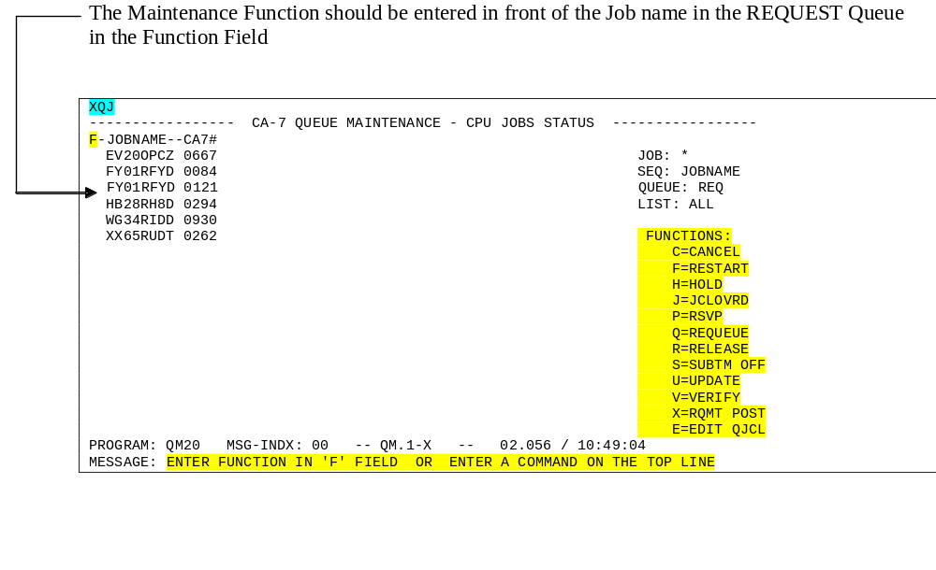
REQUEST QUEUE

Slide 49
READY QUEUE
When the Job’s dependency is satisfied (all its predecessor jobs ran good) , the Job moves from the REQUEST Queue to the READY QUEUE.
JES submits the job to MVS and the Job Picks up the JCL and Datasets while it is in the READY Queue. If it is not getting the JCL then it remains in the ready Queue as a SKELETON. Hence a Job is called a SKELETON if it is demanded without JCL.
If the Job is not getting the Dataset it requires ( Say the VSAM File held in CICS/ TSO User) then it waits in the Queue until it gets the file.
The Command to List the Job in Ready Queue is XQ,Q=RDY & is defaulted in PF07 and PF13 Keys.

Slide 50
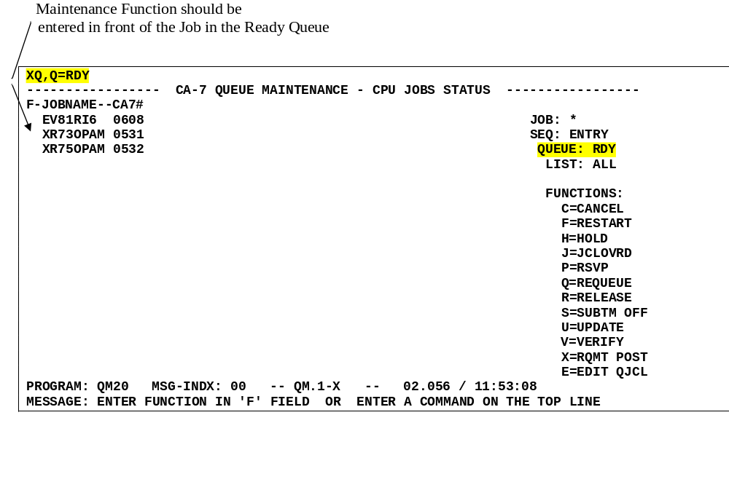
A Ready Queue Screen

Slide 51
Active Queue
When the Job successfully picks the JCL and the required resources(Datasets) then it moves into the ACTIVE Queue.
A Job in the Active Queue is said to be executing
The Job in the Active Queue gets the CPU Time for its execution based on its assigned Class and Priority.
The command to Display the Jobs in the ACTIVE Queue is
LJES
This command is defaulted in the PF06 Key
Hitting the PF06 brings up the Jobs from the Active Queue to the display.

Slide 52
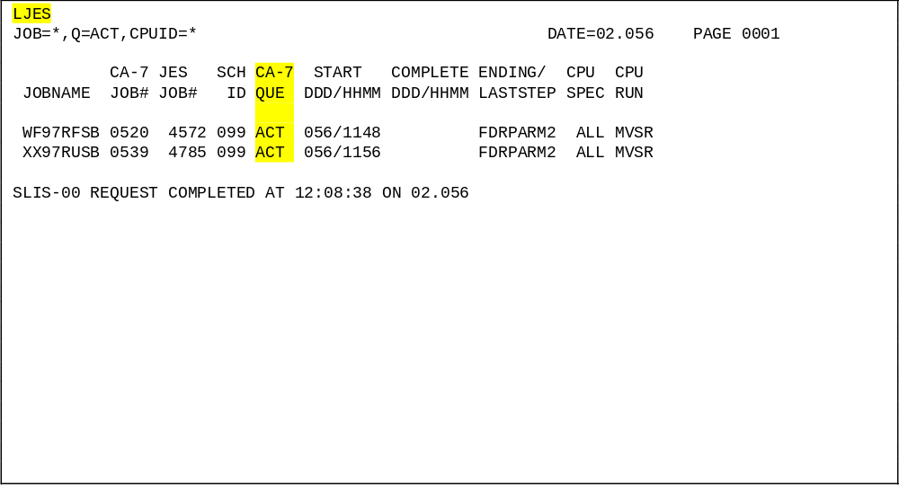
An LJES Screen...

Slide 53
Job Cycle
Triggered Job
REQ Queue
RDY Queue
Wait Till Predecessor Jobs Run Good
Pick Dataset and JCLs
Investigate, fix and restart the job which is available in request queue
EJES
SARDMP
Abend information and
job will go to request queue
ACT Queue
Abends
Finishes Execution
SARLOG
or
SARCARD

Slide 54
Commands

Slide 55
Commands
Database Commands
  Database commands are those used for defining, altering and deleting objects like Schedule or Job or Criteria in the CA Scheduler’s database.
Tracking Commands
  Tracking commands are those which are used for submitting/canceling/monitoring the status of Schedules or jobs.

Slide 56
Tracking Commands
Submit
Cancel
Post
Hold
Release
Queue
Miscellaneous

Slide 57
Submit a job
DEMAND,JOB=<jobname>,SCHID=schid
  schid = 099, Submits the demanded Job standalone
  schid = 002, executes the triggered Jobs (of the submitted) Jobs also.
  e.g.
DEMAND,JOB=WG34RUDD,SCHID=99
Executes the WG34RUDD Job standalone
DEMAND,JOB=WG40RUDD,SCHID=002
Executes the Suite of Jobs( Executing the successive Triggered Jobs)
Please Note :
DEMANDH instead of DEMAND triggers the Job with HOLD.
DEMANDH command is used if we need to verify JCLs after demanding

Slide 58
Cancel
Cancel a Job:
A Job in HOLD Queue can be Cancelled by the CANCEL command Syntax: CANCEL,JOB=<Jobname>
  e.g.: CANCEL,JOB=WG97RIDD
Force Cancel a Job:
Syntax: CANCEL,JOB=<jobname>,FORCE=Y
A Job in SKELETON Status can only be Cancelled by FORCE CANCEL command . A Skeleton Job is the Job without JCL .

Slide 59
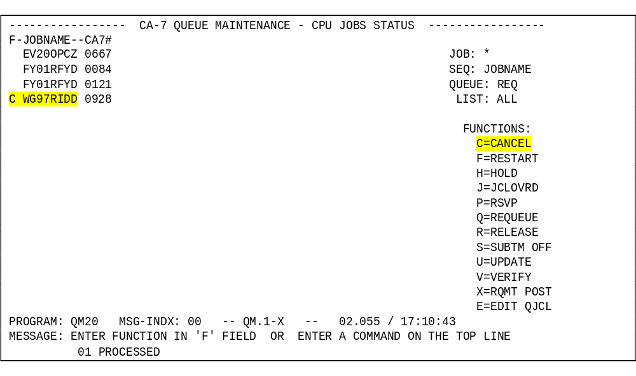
Canceling Job through Screen...

Slide 60
Requirement Post
SYNTAX :
POST,JOB=<jobname>,DSN=<dsname>,INTERNAL=YES
  The POST Function Notifies CA-7 that a requirement for a Job in the request Queue has been Satisfied.
  The Post commands satisfy predecessor conditions for the jobs which are waiting in the schedule.
  The Post command is issued against the predecessor, not the successor schedule or job.

Slide 61
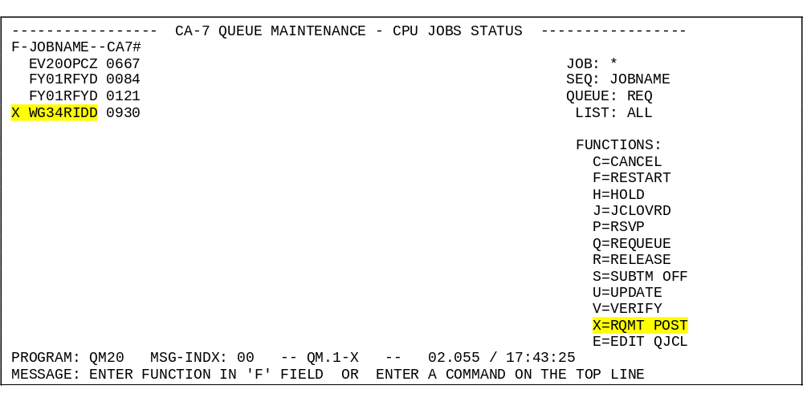
Post…Through Screens

Slide 62
Hold
This Command dynamically Modifies Normal Scheduling activity by Holding the Forward movement of a single Job or the contents
Holding a Job
HOLD,JOB=<jobname>
Adds a HOLD requirement to the Job<jobname>
e.g. :
HOLD ,JOB=WG05RUCD
Holds the Job WG05RUCD
Holding a Queue
HOLD,Q=REQ
Adds a HOLD requirement to all Jobs currently on request queue.

Slide 63
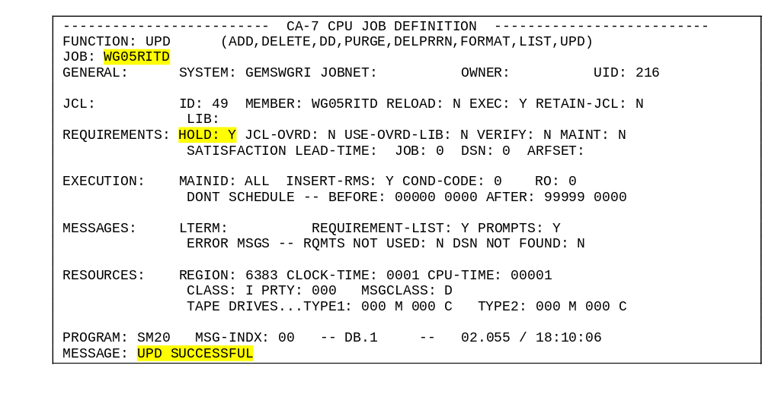
Hold… Thru Screens
The Below DB.1 Screen shows Holding the Job WG05RITD

Slide 64
JCL to hold more than one job
EDIT X.PC.SKK.MISC(HOLDS) - 01.06 Columns 00001 00072
Command ===> Scroll ===> CSR
****** ******************* Top of Data *************************
000001 //XP03T47B JOB ,CLASS=A,MSGCLASS=D,REGION=32M,PRTY=3
000002 //****MAIN PROC=WE,CLASS=OPNA
000003 //EMSJCL JCLLIB ORDER=X.PWE.BFT.PROCLIB
000004 //** OVERRIDE REQUESTED BY ??????
000005 //BATCH EXEC CA7DBTRM, ID=1
000007 //CA7DATA.SYSIN DD *
000008 JOB
000009 UPD,WEZ1RFCD,HOLD=Y
000010 UPD,WEZ2RFCD,HOLD=Y
000011 UPD,WEZ3RFCD,HOLD=Y
000012 UPD,WEZ5RFCD,HOLD=Y
000013 UPD,WES1RFCD,HOLD=Y
000014 UPD,WE03RFDD,HOLD=Y
000015 UPD,WE04RFLD,HOLD=Y
000016 UPD,WE05RFCD,HOLD=Y
000017 UPD,WE05RFDD,HOLD=Y
000018 UPD,WE05RFTD,HOLD=Y
000019 UPD,WE06RFSD,HOLD=Y
000022 //WIN EXEC PGM=CHATTER,COND=(0,NE),
000023 //LOSE EXEC PGM=PM62,
000024 // COND=(0,EQ,WIN)
000025 //*

Slide 65
Release
This Command causes normal automatic scheduling activities to be applied to Jobs that are in Hold status in CA-7 Queues
Use this command to release a Schedule or a Job from the HELD status.
The released job(s) will be run immediately if they are not waiting for predecessors or resources or time.

Slide 66
Release contd...
Releasing a Job:
Syntax:
RELEASE,JOB=<jobname>
The Job runs immediately when the below conditions are met
  Early start times have been reached.
  Predecessors have completed.
  Defined resources are available
Releasing a Queue:
Syntax:
RELEASE,Q=RDY
Releases all the Jobs held on RDY Queue by a HOLD,Q=RDY Command

Slide 67
Queue Commands
1. LJOB:
The command Lists the Information related to the Job
Syntax:
LJOB,JOB=<jobname>,LIST=<listOptions>
Commonly used List Options are
TRIG - Jobs and/or Datasets that trigger this Job as well as
all Jobs triggered by this Job
RQMT - Input rqmt and Network information Only
STEPDD - Job ,Step & DD Info only
ALL - All the Data related to the Job
NODD - Same as All without STEPDD Infos
DEPJ - Jobs which are dependant on this Job

Slide 68
For example the below screen is showing what we get when we use the command LJOB,JOB=WF00RRNC,LIST=NODD
LJOB,JOB=WF00RRNC,LIST=NODD
JOB=WF00RRNC LIST=NODD DATE=02.107 PAGE 0001
JOB ----JCL---- SYSTEM USR MAIN PROSE SCHED --NUMBER OF- LAST-RUN
NAME ID MEMBER -NAME- -ID -ID- DSNBR DSNBR STP DDS RUNS DATE/TIME
WF00RRNC 048 WF00RRNC GEMSWFRR 214 ALL *NONE* *NONE* 003 003 0001 02106/1053
--------------------------- JOB INFORMATION ---------------------------
N -- SCHD RESOLUTION REQUIRED N -- LOAD STEP TO BE EXECUTED
N -- OVERRIDE OF JCL REQUIRED N -- JOB MARKED AS MAINT ONLY
N -- MANUAL VERIFICATION REQD N -- JOB SET FOR HOLD IN REQQ
Y -- REQUIREMNTS TO BE LISTED Y -- COMP TRIGGERS OTHER JOBS
Y -- AUTO-GENERATION OF 7 RMS Y -- JOB ELIGIBLE FOR PROMPTS
N -- ERRORS FOR RQMT NOT USED Y -- JOB SET FOR EXEC ON MAIN
N -- ERRORS FOR DSN NOT FOUND N -- JCL TO BE KEPT IN PRRN/Q
. OWNER= *NONE* JCLLIB= *NUMERIC JCLID* ARFSET= *NONE*
. LAST MAINTENANCE ON 02.106 AT 10:53:00 VIA LOAD
. CLASS=R,MSGCLASS=D,REGION=6383K,PRTY=000,CPUTM=00001,ELAPTM=0001
. TAPE1: CALC=000,MANL=000,TAPE2: CALC=000,MANL=000
. # OF TIMES LATE = 0000 # OF TIMES RESTARTED = 0000
----------------- TRIGGERED BY JOBS/DATASETS/NETWORKS ------------------
JOB=WFESRRRT SCHID=002 QTM=0010 LEADTM=0000 SUBMTM=0000
--------------------------- TRIGGERED JOBS ----------------------------
JOB=WF90RRND SCHID=002 QTM=0010 LEADTM=0000 SUBMTM=0000
--------------------------- SUCCESSOR JOBS ----------------------------
JOB=WF99RRCA SCHID=002
---------------- REQUIREMENTS AND NETWORK CONNECTIONS -----------------
DSN=CCN.VSAM.TEST.DADSBIF **** PERM DSN ****
DSNBR=DS021993 SCHID=000 VRSN=02106/1053
CREATED BY **NONE**
SLIA-00 REQUEST COMPLETED AT 09:53:41 ON 02.107

Slide 69
Queue Commands contd…
2. FSTRUC
This Command produces a report displaying an entire Job Flow structure
in addition to the forecasted Time of each job in the structure based on an
arbitrary start time.
Syntax :
FSTRUC,JOB=<Jobname>,SCHID=<schid>
3. XQ,Q=RDY
The command displays the Jobs in the RDY Queue.
The command is Defaulted in PF07 and PF13 Keys
4. ARTS (Automatic Restart and Tracking System)
This Command is used to inquire and/or update the CA-11 Catalogue Management Table (CMT ) and the Job execution History File.
The command is used to change the Condition code of the Job.
The command defaulted in PF05 key

Slide 70
Queue Commands contd…
5. LJES :
The command is defaulted in the PF06 Key
This shows the list of Jobs which reside in Active Queue
E.g.: The command can be used with Wild Card
6. LRLOG:
The command is defaulted in PF09 key.
The command lists events from the CA-7 Run Log. These events include Job successful Completions,Cancels ,Force Completes and Job Restarts.
Syntax:
LRLOG,JOB=<Jobname>,SPAN=(mmddyy,hhmm, mmddyy,hhmm),ST=<stOpns>
SPAN specifies the starting and ending Date and Time
ST Controls which type of entry to be selected
Valid ST options are COMP , * , LATE, CANCEL,FORCE,RSTR,EXCP
Each selects the corresponding events only.

Slide 71
Queue Commands contd…
7. LQ:
The queue list command, lists info from the REQUEST,READY OR ACTIVE Queues. The queue list command lists information from the REQUEST, READY, OR ACTIVE QUEUES. The Queue information provided will show the status on all CA-7 Production activity.
It displays exhaustive information about all Jobs( Both wanted and undesired).Hence the
LQ command is often filtered to display the desired Jobs in the queue only.
Syntax:
LQ,JOB=<Jobname with Wild Cards>,SYS=<sys Options>
E.g.:
LQ,JOB=WG**RU**
The command displays only the Jobs whose name fall in this convention only from all the queues.
If the Jobs WG**RU** are assigned to a system ( Say GEMSWGRU) then the below command
can be used to display the same information.
LQ,SYS=GEMSWGRU
The below command assigns the above LQ command to the PF02 key.
/PF02,MSG=(LQ,SYS=GEMSWGRU)

Slide 72
Queue Commands contd…
8 . LACT
The queue list command, lists info from the ACTIVE Queue only.
Rest is same as LQ command
Syntax: LACT,JOB=<Job name with Wild Cards>,SYS=<sys Options>
9. LREQ
This queue list command, lists info from the REQUEST Queue only.
Syntax: LREQ,JOB=<Job name with Wild Cards>,SYS=<sys Options>
10.LRDY
The queue list command, lists info from the READY Queues only.
Syntax: LRDY,JOB=<Job name with Wild Cards>,SYS=<sys Options>

Slide 73
Queue Commands contd…
The below example shows the screen out put when we use a queue command, which gives the latest log of a particular job includes start, end and job completion status.
LPRRN,JOB=WF00RRNC
LIST=STATUS JOB=WF00RRNC DATE=02.107 PAGE 0001
JOB CA-7 DEADLINE START DUE-OUT COMPLETE CPU SCH ENTRY JOB
NAME JOB# DDD/HHMM DDD/HHMM DDD/HHMM YYDDD/HHMM SPEC/RUN ID MODE STATUS
WF00RRNC 0851 106/1059 106/1053 106/1104 02106/1054 ALL-MVSR 002 AUTO C-C0000
SLIF-00 REQUEST COMPLETED AT 10:33:01 ON 02.107

Slide 74
Miscellaneous Commands
Scroll Commands
very often the output created by a command(say LQ) spans across several pages. The CA7 has a strange system for paging the outputs.
/PAGE-1 , scrolls to the previous page
/PAGE+1, Scrolls to the next page (Also
Enter key can be used)
/PAGE=N ,Takes to the page N.
/PF99 , Deletes all the PF key settings and assigns the defaults settings
/DISPLAY,ST=KEY Displays all the PF Key settings

Slide 75
Miscellaneous Commands contd…
/PFnn,MSG=<CA7 command> assigns a desired CA7 command the function key
e.g.: /PF02,MSG=(LQ,JOB=WF**RF**)
Assigns the PF02 Key to display the LQ command.
/PROF,KEYS=SAVE
This command saves the current Key settings. So that they are available in next session.
/PROF,SAVE=KEYS
This command shows the modified PF keys information

Slide 76
Miscellaneous Commands contd…
The Example below shows the screen out put when we use the display command /PROF,SAVE=KEYS
/PROF,SAVE=KEYS
* CA-7 PROFILE: ID=XP03T47 R=CA70212 MAINT=02.107/10:42 BY XP03T47 PAGE 0001
OPTS=
PF01 XQ,JOB=WF*,Q=REQ
PF02 LQ,SYS=GEMSWFRR
PF03 LJOB,JOB=XXR5RIZA,LIST=NODD
PF07 XQ,JOB=WF*,Q=RDY
SCMP-00 DISPLAY COMPLETE AT 10:42:46 ON 02.107.

Slide 77
Tips

Slide 78
Clearing the Condition code
How to clear the condition Code of a step?
Go to Automatic Restart Tracking System (ARTS,PF05 key) type in the command and you will get the following screen
LSTP,WF06RRDD
CA-11 ONLINE - JOB STEP INQUIRY FOR JOB WF06RRDD
JOB IS RESTARTABLE.
JOB IS NOT SET FOR RESTART.
STEP LAST HIGH CONDITION CODE
STEP# PROCSTEP STEPNAME RESTARTABLE RTCD RTCD CHECKS TO RMS STEP
001 WF06 DELETES YES 0000
002 WF06 EGD20SR1 YES 0000
003 WF06 EGDD020 YES U0999
004 WF06 ARD011 YES NOEX
005 WF06 WIN YES NOEX
006 WF06 LOSE YES NOEX
--- ONLINE STEP INQUIRY ENDED ---
U11-411 ENTER CA-11 ONLINE COMMAND ?

Slide 79
Clearing the Condition code contd…
In the same screen type in the command to update the particular step’s return code of that job
CUPD,WF06RRDD,EGDD020
CA-11 ONLINE - CA-11 ONLINE CMT INQUIRY/UPDATE
JOB=WF06RRDD
PROCSTEP/STEP=WF06 /EGDD020
STEP RECID=3 BTCHID=101 PROCSTEP/STEP=WF06 /EGDD020 SEQNO=003
LOGIC=00 LRTCD=U0999 HIRTCD=0000 NBRCC=0 CC1=NONE CC2=NONE
CC3=NONE CC4=NONE CC5=NONE CC6=NONE CC7=NONE CC8=NONE
U11-445 AWAITING NEXT REPLY / COMMAND ?

Slide 80
Clearing the Condition code contd…
Replacing the last step’s return code with 000, so that we can restart that job from the next step, in this example from ARD011 step. Type ‘U’ to update the LRTCD with new code or ‘R’ to come out of the screen without changing the condition code of that step. Without clearing down the return code EJES will not submit the job to the CPU if condition code parameter coded in the JCL, but in all the scheduled jobs condition code parameter will be coded in the JCL to prevent the jobs running if the previous step failed.
REP LRTCD=0000
LRTCD CHANGED FROM - U0999 TO - 0000
U11-446 REPLY 'U' TO UPDATE -- 'R' TO REJECT

Slide 81
Clearing the Condition code contd…
After clearing down the condition code of that step the screen will look like as follows.
LSTP,WF06RRDD
CA-11 ONLINE - JOB STEP INQUIRY FOR JOB WF06RRDD
JOB IS RESTARTABLE.
JOB IS NOT SET FOR RESTART.
STEP LAST HIGH CONDITION CODE
STEP# PROCSTEP STEPNAME RESTARTABLE RTCD RTCD CHECKS TO RMS STEP
001 WF06 DELETES YES 0000
002 WF06 EGD20SR1 YES 0000
003 WF06 EGDD020 YES 0000
004 WF06 ARD011 YES NOEX
005 WF06 WIN YES NOEX
006 WF06 LOSE YES NOEX
--- ONLINE STEP INQUIRY ENDED ---
U11-411 ENTER CA-11 ONLINE COMMAND ?

Slide 82
Tips...
Date tables or Calendars?
Date tables provide more flexibility than calendars.
When schedule has to run according to a set of dates that follows no pattern, Calendar can be used.

Slide 83
Tips
How to Organize Schedules?
A schedule should consist of a group of logically related jobs. This group of jobs usually belongs to one application, but could also be run at the same frequency.
All jobs in a schedule need not be selected for a day’s workload.
Job level options override Schedule level options

Slide 84
Tips
When a Job is submitted?
Once the job’s Early time is met, and all of its predecessors have completed normally, and if its resources are available.

Slide 85
Restarting a Job
    How to Clear the Condition Code of an Abended Job and resubmit it
LSTP,WF06RRDD
CA-11 ONLINE - JOB STEP INQUIRY FOR JOB WF06RRDD
JOB IS RESTARTABLE.
JOB IS NOT SET FOR RESTART.
STEP LAST HIGH CONDITION CODE
STEP# PROCSTEP STEPNAME RESTARTABLE RTCD RTCD CHECKS TO RMS STEP
001 WF06 DELETES YES 0000
002 WF06 EGD20SR1 YES 0000
003 WF06 EGDD020 YES U0999
004 WF06 ARD011 YES NOEX
005 WF06 WIN YES NOEX
006 WF06 LOSE YES NOEX
--- ONLINE STEP INQUIRY ENDED ---
U11-411 ENTER CA-11 ONLINE COMMAND ?

Slide 86
Restarting a Job Contd…
Update the condition code of the abandoned step, LRTCD is Last step’s ReTurn CoDe.
CUPD,WF06RRDD,EGDD020
CA-11 ONLINE - CA-11 ONLINE CMT INQUIRY/UPDATE
JOB=WF06RRDD
PROCSTEP/STEP=WF06 /EGDD020
STEP RECID=3 BTCHID=101 PROCSTEP/STEP=WF06 /EGDD020 SEQNO=003
LOGIC=00 LRTCD=U0999 HIRTCD=0000 NBRCC=0 CC1=NONE CC2=NONE
CC3=NONE CC4=NONE CC5=NONE CC6=NONE CC7=NONE CC8=NONE
U11-445 AWAITING NEXT REPLY / COMMAND ?
REP LRTCD=0000
LRTCD CHANGED FROM - U0999
TO - 0000
U11-446 REPLY 'U' TO UPDATE -- 'R' TO REJECT

Slide 87
Restarting a Job Contd…
After clearing down the condition code go to the request queue (PF01), locate that job and restart the job by entering ‘F’ in front of that job while it is in the request queue
------------ CA-7 QUEUE MAINTENANCE - CPU JOB IN RESTART STATUS -----------
JOB: WF06RRDD CODE: U0999 LAST-STEP: EGDD020 MCNT: 001
CA-7#: 0805 JES#: 39871 NODE-NAME: LOCAL
REASON: invalid date/time stamp
-- -- RESUBMIT FOR PRODUCTION
-- -- FORCE COMPLETE
-- x -- CA-11 RESTART/RERUN PSEUDO: NO
START: EGDD020 END:
CC: BYPGDG: USAGE: LRTCD: = 0
CMT STATUS: CMT SHOWS JOB IS SET FOR PRODUCTION
-- -- SET PARM DATA FOR RMS AND RESUBMIT
PARM:
-- -- DO NOT INSERT RMS PROC BUT RESUBMIT
PROGRAM: QM50 MSG-INDX: 00 -- QM.4-X -- 02.106 / 12:57:02
MESSAGE: 'X' THE DESIRED FUNCTION OR ENTER A COMMAND ON THE TOP LINE
*WARNING* - RESTART/RERUN COULD SCRATCH GOOD DATASETS

Slide 88
Online CA-7 HELP
Its Very useful utility resided in Scheduler.
Can get Command Syntax, Format, Details and its Use
Can list all the available commands
By Typing HELP in the command line you can get the following screen

Slide 89
Online CA-7 HELP Contd…
--------------------------- CA-7 ONLINE TUTORIAL ---------------------------
FUNCTION ===> (LEAVE BLANK EXCEPT TO TRANSFER)
INDEX: (Y = INDEX OF ALL COMMANDS)
APPLICATION: (VALUE FROM FOLLOWING LIST OR SPECIFIC 4 CHAR NAME)
1 - GENERAL INQUIRY 6 - RESTARTING A JOB 11 - MGMT GRAPHS
2 - QUEUE MAINT 7 - DATA BASE MAINT 12 - RPT PROCESSING
3 - QUEUE MGMT/POSTING 8 - DATA BASE ANALYZE 13 - PERSONAL SCHED
4 - SYSTEM COMMANDS 9 - SCHED RESOLUTION 14 - VRM MAINT
5 - UTILITIES 10 - FORECASTING 15 - ARF
COMMAND: (SPECIFIC COMMAND NAME, UP TO 8 CHARACTERS)
FORMAT: (Y = SAMPLE FORMAT)
EXAMPLE: (Y = COMMAND EXAMPLE)
GENERAL: (Y = GENERAL DISCUSSION)
DETAIL: (Y = DETAILED EXPLANATION)
PROGRAM: HLPM MSG-INDX: 00 -- HELP -- 02.109 / 10:10:00
MESSAGE: ENTER VALUES, TRANSFER OR ENTER A COMMAND ON THE TOP LINE

Slide 90
Online CA-7 HELP Contd…
When we type ‘Y’ in the INDEX field we get list of commands as follows
INDEX
CA-7 - HELP FACILITY PAGE 001
ADDRQ - (SPO0) ADD A TEMPORARY JOB DEPENDENCY OR USER REQUIREMENT.
ADDSCH - (SPO0) DELAY SCHEDULED START AND DUE-OUT TIMES BY UP TO
24 HOURS.
AL - (UTL0) ALLOCATE A DATA SET.
ALC - (UTL0) ALLOCATE AND CATALOG A DATA SET.
ALLOC - (UTL0) DYNAMICALLY ALLOCATE A VOLUME UNDER MVS.
APA - (MLR0) MENU OF STATISTICAL GRAPHS.
AR - (AR00) AUTOMATED RECOVERY FACILITY (ARF).
ARFP - (SPO0) PURGE ARF ELEMENTS FOR A JOB IN THE QUEUES.
ARTS - (UTL0) INQUIRY AND UPDATE TO CA-11 CMT AND JEHF.
BLDG - (UTL0) BUILD A GENERATION DATA GROUP INDEX.
CALMOD - (SDM0) ONLINE CALENDAR MAINTENANCE.
CANCEL - (SPO0) REMOVE JOBS AND SCHEDULED WORKSTATIONS FROM THE
CA-7 QUEUES.
CAT - (UTL0) CATALOG A DATA SET.
CONN - (UTL0) CONNECT HIGH LEVEL CATALOG INDEXES.
CTLG - (SPO0) MAINTENANCE FACILITY FOR CA-7 CATALOG.
DB - (SDM0) DATA BASE MAINTENANCE.
And so on up to 15 pages as per the available help facility

Slide 91
Online CA-7 HELP Contd…
If we need help to restart a job we can enter option ‘6’ in the Application field, and what we get is two page information as below….
SJR0
CA-7 - HELP FACILITY PAGE 001
THE JOB RESTART FACITITY MAY BE USED TO RESTART OR RERUN JOBS
WHICH FAILED DURING EXECUTION OR WHICH RAN INCORRECTLY.
THE COMMANDS AVAILABLE HERE ARE ---
LIST - LISTS JOBS THAT REQUIRE RESTART.
RESTART - RESTARTS/RESUBMITS/FORCE COMPLETES A JOB,
WITH OR WITHOUT CA-11.
THE QUEUE MAINTENANCE (SQM0) APPLICATION OFFERS A FORMATTED
SCREEN (XRST) WITH WHICH JOB RESTARTS MAY BE DONE ONLINE. THE
RESTART COMMAND CAN BE USED EITHER ONLINE, AS A TOP LINE COMMAND,
OR IN BATCH MODE.
___ ___
LIST | ,JOB=,PROSE= |
|___ ___|

Slide 92
Help screen to restart a job
SJR0
CA-7 - HELP FACILITY PAGE 002
___ _
RESTART,JOB= | ,PROCSTRT= ,PROCEND= ,STPSTRT= ,STPEND= |
| ,PROCESS= ,CONDCD= ,FORCECOMP= ,SUP11STP= |
| ,BYPGDG= ,REASON= ,USAGE= |
| ,LCC= ,LPSTP= ,LSTP= |
|___ __|
HLP0-00 HELP REQUEST COMPLETED AT 11:14:38 ON 02.109.

Slide 93
Online CA-7 HELP Contd…
To get help about a specific command say LPRRN type the command in the command field. Default option is to display Format, Example, General and Detail.
LPRRN
CA-7 - HELP FACILITY PAGE 001
THE LPRRN COMMANDN LISTS INFORMATION FROM THE CA-7 PRN
QUEUE.
___ ___
LPRRN | ,JOB= ,SEQ= ,LIST= ,SEG= ,SYS= |
|___ ___|
JOB= - DESIRED JOB(S). SPECIFIC 1-8 CHARACTER NAME OR GENERIC
NAME (1-7 CHARACTERS ENDED BY AN ASTERISK (*)). JOB=*
WILL LIST ALL JOBS AND IS THE DEFAULT.
SEQ= - DESIRED DISPLAY SEQUENCE -
NATV - NATIVE SEQUENCE (I.E., ORDER IN WHICH IT
ENTERED THE QUEUE). (DEFAULT).
JOB - JOBNAME SEQUENCE.
LIST= - AMOUNT OF QUEUE INFORMATION DESIRED.

Slide 94
Default LPRRN help screen
LPRRN
CA-7 - HELP FACILITY PAGE 002
Q - JOB DATA ONLY
JCL - JCL FROM LAST GOOD RUN
ALL - ALL DATA RELATIVE TO THE QUEUE
PROSE - PROSE DATA FROM DATA BASE
WHEN OMITTED, DEFAULT DISPLAY OF A SINGLE LINE FOR
EACH QUEUE RECORD WILL BE SHOWN.
SEG= - SECTION AND SUB-SECTION OF PROSE TO BE LISTED. FORMAT
IS SEG=(X,Y) WHERE 'X' IS THE 1-8 CHARACTER SECTION
NAME AND 'Y' IS THE 1-8 CHARACTER SUB-SECTION NAME.
SYS= - SPECIFIES SYSTEM NAME FOR SELECTION. CAN BE SPECIFIC,
GENERIC, OR * .
LPRRN
LPRRN,JOB=PAYROLL
LPRRN,SEQ=JOB,LIST=Q
LPRRN,JOB=PAYROLL,LIST=JCL
HLP0-00 HELP REQUEST COMPLETED AT 11:24:17 ON 02.109.

Slide 95
Default LRLOG help screen
LRLOG,INST
CA-7 - HELP FACILITY PAGE 001
___ ___
LRLOG | ,JOB= ,SYS= ,SCHID= ,NW= ,SUBID= |
| ,SPAN= ,DATE= ,SEQ= ,ST= ,LIST= ,OPT= |
|___ ___|
HLP0-00 HELP REQUEST COMPLETED AT 11:34:49 ON 02.109.

Slide 96
Online CA-7 HELP Contd…
Even all the system commands can be displayed by entering system command option ‘4’ in Application field
SCM0
CA-7 - HELP FACILITY PAGE 002
THE SYSTEM COMMANDS ARE AS FOLLOWS ---
/ASSIGN - MODIFY CPU IDENTIFICATION, JOB BARRIER LIMITS, OR
LOGICAL TERMINAL ASSIGNMENTS
/AUTO - REPEAT A CA-7 ONLINE COMMAND ON A TIME INTERVAL
/BRO - BROADCAST A QUEUED MESSAGE TO ALL CA-7 TERMINALS
/CHANGE - MODIFY THE SECURITY DEFINITION FOR A GIVEN OPERATOR
/CLOSE - CLOSE A TERMINAL, LINE, OR LINE GROUP TO PROCESSING
/COPY - COPY A PAGE OF DISPLAY FROM ONE TERMINAL TO ANOTHER
/DISPLAY - REVIEW TERMINAL NETWORK AND INTERNAL SYSTEM STATUS
/ECHO - PREFORMAT A COMMAND LINE FOR A 3270-TYPE TERMINAL
/FETCH - RETRIEVE VTAM TERMINAL COMMAND
/JCL - ADD/UPDATE/DELETE A SYMBOLIC JCL STATEMENT
/LOG - WRITE A FREE FORM MESSAGE TO THE LOG DATA SET
/LOGOFF - END A TERMINAL SESSION
/LOGON - START A TERMINAL SESSION
/MSG - SEND A FREE FORM MESSAGE TO ANOTHER TERMINAL
/NXTMSG - REVIEW SECONDARY OUTPUT MESSAGES
and on…………..

Slide 97
Sample Batch JCLs

Slide 98
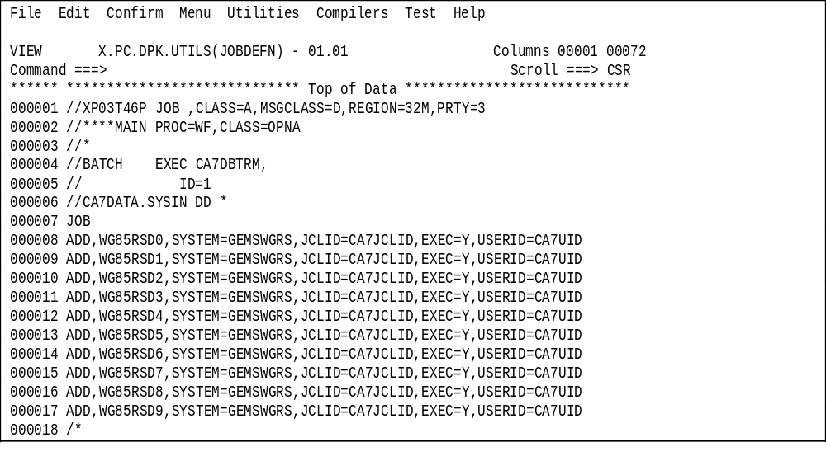
Sample JCL for executing Database Commands
The Below JCL Introduces few Jobs(WG85RSD*) to the GEMSWGRS System

Slide 99
Sample Batch JCL Contd…
The example below shows a sample JCL to add successor jobs in the schedule
//XP03T47P JOB ,CLASS=A,MSGCLASS=D,REGION=32M,PRTY=3
//****MAIN PROC=WF,CLASS=OPNA
//*
//BATCH EXEC CA7DBTRM,
// ID=1
//CA7DATA.SYSIN DD *
UPD,JTRG,OPT=A,JOB=XPESTART,TJOB=XP99OPCA,SCHID=002,QTM=0010
UPD,JTRG,OPT=A,JOB=XPSTART ,TJOB=XP00OPSW,SCHID=002,QTM=0010
UPD,JTRG,OPT=A,JOB=XP00OPSW,TJOB=XP00OPCN,SCHID=002,QTM=0010
UPD,JTRG,OPT=A,JOB=XP00OPCN,TJOB=XPS0OPCD,SCHID=002,QTM=0010
UPD,JTRG,OPT=A,JOB=XPS0OPCD,TJOB=XP01OPCD,SCHID=002,QTM=0010
UPD,JTRG,OPT=A,JOB=XPS0OPCD,TJOB=XP01OPC0,SCHID=002,QTM=0010
UPD,JTRG,OPT=A,JOB=XPS0OPCD,TJOB=XP01OPC1,SCHID=002,QTM=0010
UPD,JTRG,OPT=A,JOB=XPS0OPCD,TJOB=XP01OPC2,SCHID=002,QTM=0010
/*
//*
//*
//WIN EXEC PGM=CHATTER,
// COND=(0,NE),
// PARM='===> XPCAOPBT JOB COMPLETED SUCCESSFULLY <==='
//*
//LOSE EXEC PGM=PM62,
// COND=(0,EQ,WIN)
//*

Slide 100
Sample Batch JCL Contd…
The example below shows a sample JCL to add predecessor (requirement) jobs in the schedule
//XP03T47P JOB ,CLASS=A,MSGCLASS=D,REGION=32M,PRTY=3
//****MAIN PROC=WF,CLASS=OPNA
//*
//BATCH EXEC CA7DBTRM,
// ID=1
//CA7DATA.SYSIN DD *
UPD,JOB,XP00OPCA,OPT=A,PRED=XP0BCICS,SCHID=002,LEADTM=0002
UPD,JOB,XP00OPCN,OPT=A,PRED=XP0ACICS,SCHID=002,LEADTM=0002
UPD,JOB,XP05OPCD,OPT=A,PRED=XPZ0OPCD,SCHID=002,LEADTM=0005
UPD,JOB,XP06OPCD,OPT=A,PRED=XP05OPAD,SCHID=002,LEADTM=0005
UPD,JOB,XP12OPC1,OPT=A,PRED=XPZ2OPCD,SCHID=002,LEADTM=0005
UPD,JOB,XP12OPC2,OPT=A,PRED=XPZ2OPCD,SCHID=002,LEADTM=0005
UPD,JOB,XP12OPC3,OPT=A,PRED=XPZ2OPCD,SCHID=002,LEADTM=0005
UPD,JOB,XP12OPC4,OPT=A,PRED=XPZ2OPCD,SCHID=002,LEADTM=0005
UPD,JOB,XP12OPC5,OPT=A,PRED=XPZ2OPCD,SCHID=002,LEADTM=0005
UPD,JOB,XP12OPC6,OPT=A,PRED=XPZ2OPCD,SCHID=002,LEADTM=0005
/*
//*
//*
//WIN EXEC PGM=CHATTER,
// COND=(0,NE),
// PARM='===> XPCAOPBT JOB COMPLETED SUCCESSFULLY <==='
//*
//LOSE EXEC PGM=PM62,
// COND=(0,EQ,WIN)
//*

Slide 101
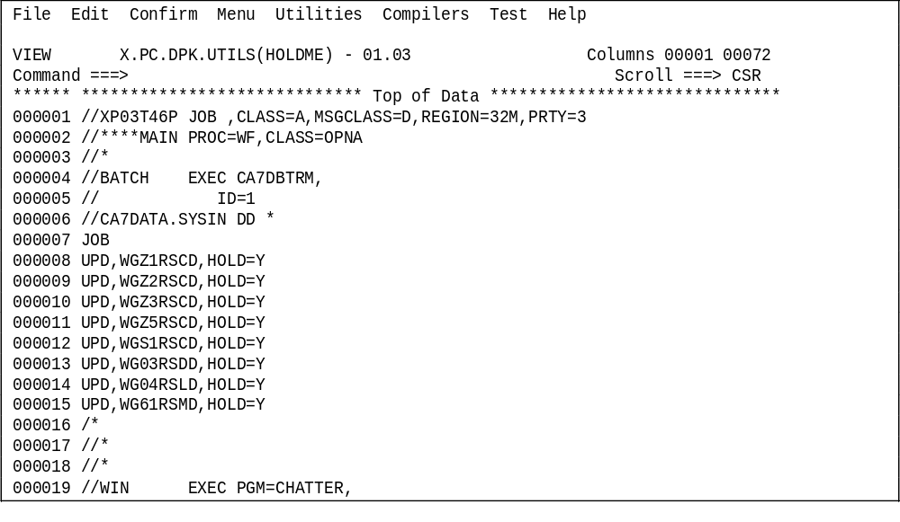
Sample JCL for executing Tracking Commands
The Below JCL applies the User Holds on the Jobs
Sample Batch JCL Contd…

